Slide 1


Green Pace
Security Policy Presentation
Developer: Dane Clark

Slide 2

OVERVIEW: DEFENSE IN DEPTH
This security policy will define security principles as well as, walkthrough the coding standards for C/C++. Additionally, this policy will address different types of encryption methods. The policy will demonstrate the proper approach to defense in depth as well as help staff develop and implement secure coding standards.

Slide 3
THREATS MATRIX
Higher priority threats should be addressed immediately as these have the highest likelihood of causing damage.
Lower priority risks should also still be addressed even though the likelihood of occurring or causing harm minimal. It is still good practice to address risk as they arise.
Likely STR-50-CPP MEM-50-CPP ERR-51-CPP INT-30-C MEM-52-CPP EXP-53-CPP | Priority STR-50-CPP MEM-50-CPP INT-30-C MEM-52-CPP EXP-53-CPP
Low priority INT-50-CPP EXP-52-CPP ERR-51-CPP | Unlikely INT-50-CPP EXP-52-CPP

Slide 4
10 PRINCIPLES
Validate Input Data
Heed Compiler Warnings
Architect and Design for Security Policies
Keep It Simple
Default Deny
Adhere to the Principle of Least Privilege
Sanitize Data Sent to Other Systems
Practice Defense in Depth
Use Effective Quality Assurance Techniques
Adopt a Secure Coding Standard

Slide 5
CODING STANDARDS
Data Type
Data Value
Integer Overflow and Underflow
String Correctness
SQL Injection
Memory Protection
Assertions
Exceptions
Resource Management
Expressions

Slide 6
ENCRYPTION POLICIES
Encryption at rest -This policy applies to data that is stored on any type of device, such as servers, laptops, or USB drives (Smith, 2020). All data stored on company-owned devices must be encrypted to prevent unauthorized access in case of theft or loss. Encryption at rest must be enforced using strong encryption algorithms such as AES-256 or RSA-4096.
Encryption at flight - This policy requires all data in transit to be encrypted using an approved encryption algorithm (NIST, 2018). This policy applies to data that is being transmitted across a network, such as emails or online transactions. All data transmitted over company-owned networks must be encrypted to prevent unauthorized access or interception. Encryption in flight must be enforced using secure protocols such as SSL/TLS.
Encryption in use - This policy requires all sensitive data processed or used on company systems to be encrypted using an approved encryption algorithm (Smith, 2020). This policy applies to data that is being processed by an application or stored in memory. All sensitive data must be encrypted while in use to prevent unauthorized access in case of application exploits. Encryption in use must be enforced using secure libraries or hardware encryption devices.

Slide 7
TRIPLE-A POLICIES
Authentication - All users and systems must be authenticated before accessing any company-owned resources. Authentication must be enforced using strong authentication methods such as multi-factor authentication (MFA) or biometric authentication.
Authorization - This policy applies to the process of granting access to company-owned resources. All access to company-owned resources must be authorized based on the user or system's role and responsibility. Authorization must be enforced using access control mechanisms such as Role-Based Access Control (RBAC) or Attribute-Based Access Control (ABAC).
Accounting - This policy applies to the process of tracking the usage of company-owned resources. All activities performed by users or systems must be logged and audited regularly to detect any unauthorized access or suspicious activity. Accounting must be enforced using secure logging mechanisms and regular auditing.

Slide 8
Unit Testing
One example of a coding vulnerability is an SQL injection attack. SQL injection is a type of security vulnerability that can occur in a website or application that uses SQL (Structured Query Language) to interact with a database. It happens when an attacker inputs malicious SQL code into a text field on a web page or application that is designed to interact with a database, and that code is then executed by the database. The purpose of SQL injection is to enable an attacker to access or modify data in a database that they should not have access to, or to execute arbitrary commands on the server hosting the database.
Here are some positive and negative test cases to check for SQL injection vulnerabilities:

Slide 9
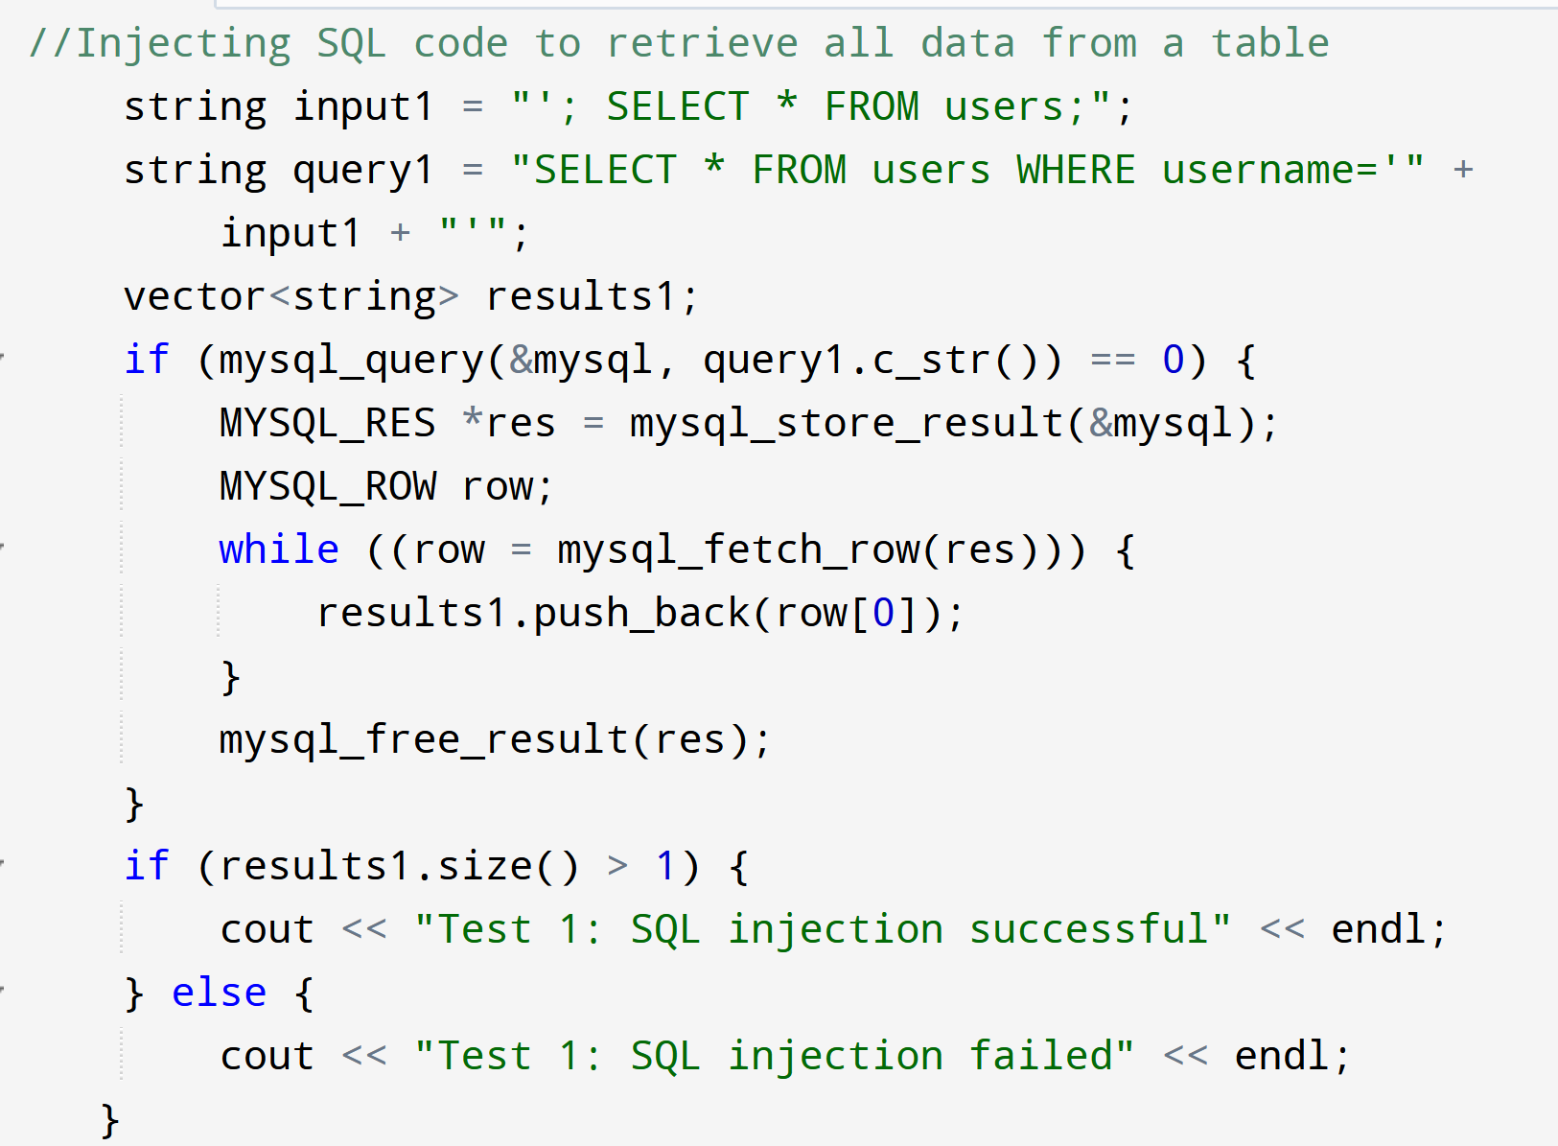
Positive Test 1
Injecting SQL code to retrieve all data from a table

Slide 10
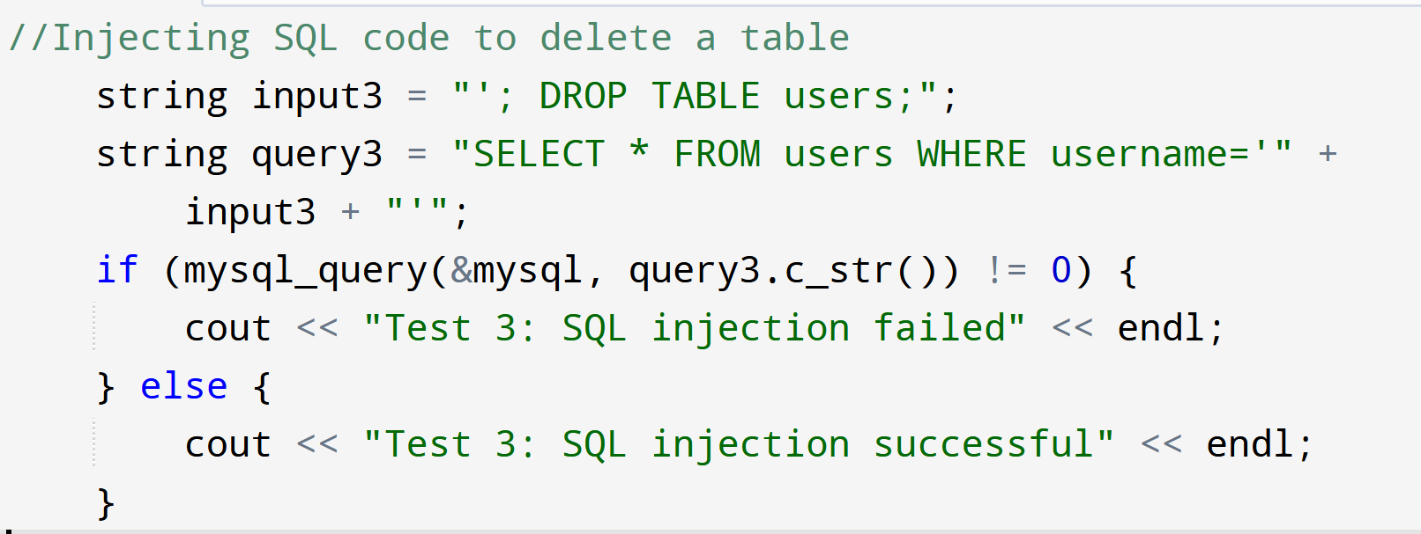
Positive Test 2
Injecting SQL code to delete a table

Slide 11
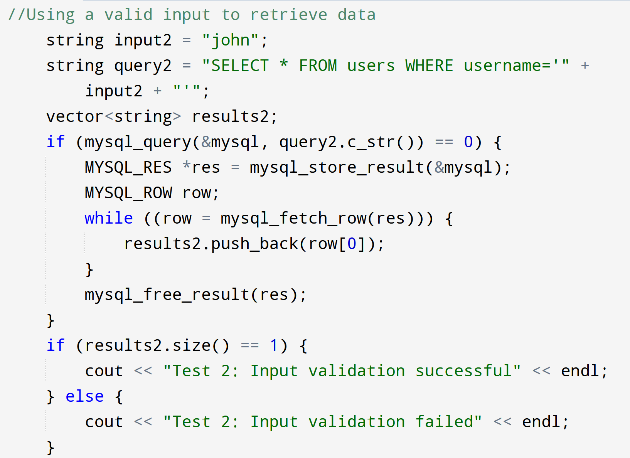
Negative Test 1
Using a valid input to retrieve data

Slide 12
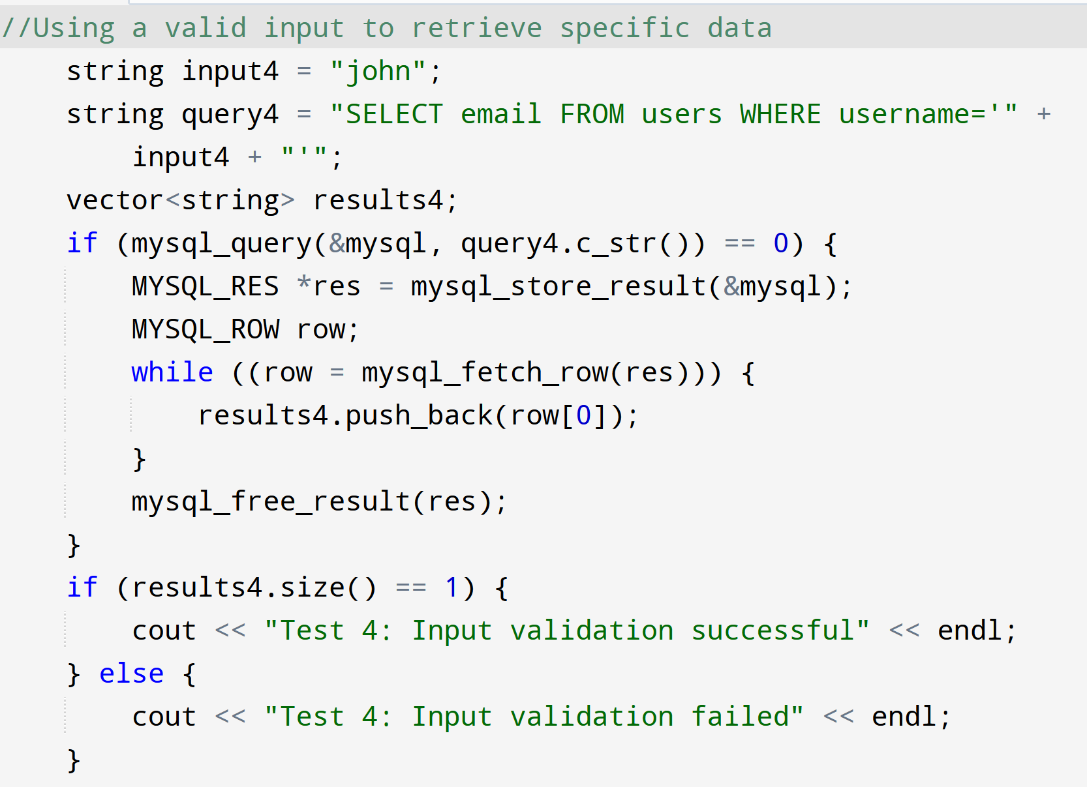
Negative Test 2
Using a valid input to retrieve specific data

Slide 13

AUTOMATION SUMMARY
To automate the enforcement of the standards defined in this policy, we can integrate automated security testing and compliance checks into each stage of the DevOps process. For example, in the planning stage, we can incorporate security requirements and risk assessments into the user stories and backlog items.

Slide 14
TOOLS
DevSecOps is a methodology that integrates security practices into the DevOps pipeline to ensure that security is an integral part of the software development lifecycle. It enables organizations to implement a proactive approach to security by shifting security left in the development process, rather than addressing it as an afterthought. A DevSecOps pipeline includes a set of tools, processes, and practices that enable teams to deliver secure and reliable software at a faster pace.
Dynamic analysis tools like Valgrind and GDB are used to debug and profile C++ code, helping developers identify and fix issues related to memory management, data corruption, and other runtime errors (Hajkova, 2021).
Continuous Integration/Continuous Deployment (CI/CD) tools like Jenkins, CircleCI, and TravisCI automate the build, testing, and deployment processes, ensuring faster delivery of code to production while reducing the risk of errors (Continuous Integration, 2023).
Static code analysis tools like Clang-Tidy and Cppcheck analyze the C++ code for potential security vulnerabilities, helping developers identify and fix security issues early in the development process (Alekseev, 2016).
Identity and access management tools like Okta and Ping Identity manage user identities and permissions to ensure secure access to the system, helping to enforce security policies and prevent unauthorized access (La Forte, 2022).
Notes:
By integrating security into the DevOps pipeline, organizations can ensure that their software is more secure and reliable. The DevSecOps approach enables teams to identify and address security issues earlier in the development process, reducing the risk of vulnerabilities being exploited in production

Slide 15
RISKS AND BENEFITS
Pros
Early detection of problems
Cost savings in long term
Continuous monitoring
Stronger defense to attack
Easier to maintain
Cons
Upfront cost increase
More knowledgeable staff needed
More complexity could lead to unforeseen issues

Slide 16
RECOMMENDATIONS
This policy does not account for post-production response. Often there are issue that the public will find both with the functionality and vulnerability of the program.
There is no plan in place for implementing this policy. The recommendation would be to address this policy with all staff to ensure the policy plan is understood and followed.
Accurately report any issue as they arise for documentation purposes. The same is true for remedies to any of those issues.
Continued growth and development of the above policy.

Slide 17
CONCLUSIONS
Validate Input Data
Heed Compiler Warnings
Architect and Design for Security Policies
Keep It Simple
Use Effective Quality Assurance Techniques
Adopt a Secure Coding Standard

Slide 18
REFERENCES
Smith, J. (2020). Encryption at Rest and Encryption in Use Policies. Retrieved from https://www.example.com/encryption-policies
NIST. (2017). Authentication and Authorization Policies. Retrieved from https://www.nist.gov/cyberframework/online-learning/authentication-and-authorization-policies
NIST. (2018). Guide to TLS. Retrieved from https://nvlpubs.nist.gov/nistpubs/SpecialPublications/NIST.SP.800-52r1.pdf
Hajkova, P, A. (2021). Debug memory errors with Valgrind and GDB. https://developers.redhat.com/articles/2021/11/01/debug-memory-errors-valgrind-and-gdb#https://developers.redhat.com/articles/2021/11/01/debug-memory-errors-valgrind-and-gdb#
n.a. (2023) Continuous Integration: CircleCI vs Travis CI vs Jenkins vs AlternativesContinuous Integration: CircleCI vs Travis CI vs Jenkins vs Alternatives. https://djangostars.com/blog/continuous-integration-circleci-vs-travisci-vs-jenkins/
Alekseev, A. (2021). An Overview of Static Analyzers for C/C++ Code. https://pvs-studio.com/en/blog/posts/0397/https://pvs-studio.com/en/blog/posts/0397/https://pvs-studio.com/en/blog/posts/0397/
La Forte, J. (2022). Okta vs Ping: IAM software comparison. https://www.techrepublic.com/article/okta-vs-ping/

